Slide 1
Patching Up – Algebra & other stories

Slide 2
Goals for this session
What we want out of this session:
→ Get more comfortable with linear algebra.
→ Get a better visual/intuitive understanding for vectors and matrices.
→ Get a better mathematical understanding of regression and the like.
→ Understand the “simple” stuff – rather than implement the complicated stuff (as we typically do here at cognitive science).
Notes:
Most hand-calculation initially and then more in R later.

Slide 3
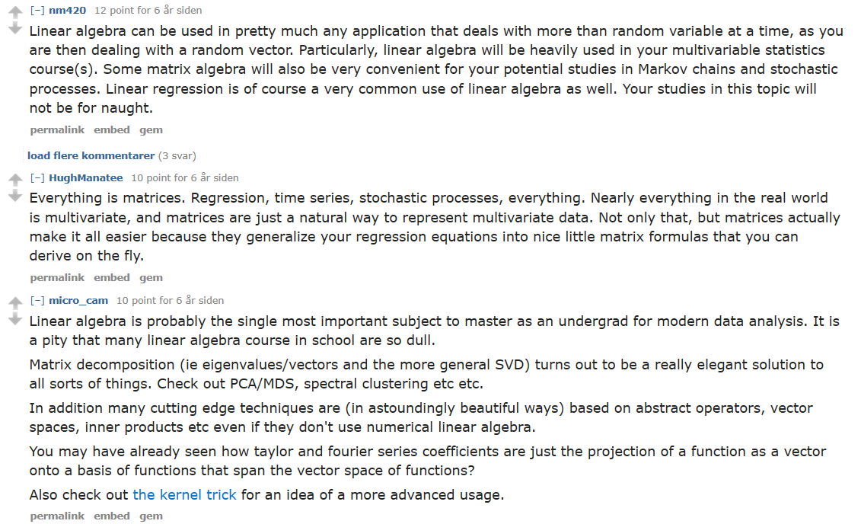
Use-cases of linear algebra

Slide 4
The stuff that we will discuss
1. Statistics (regression)
→ Regression (t-test, ANOVA, linear- and multiple regression).
→ Least squares (fitting a line).
→ R-squared & F-statistic (comparison of model fit).
2. Machine Learning
NLP (e.g. word embeddings).
PCA (eigen-vectors) if we have time.
Notes:
PCA: not in as much depth.

Slide 5
Plan
1. Basics of vectors and matrices.
Exercises
2. Linear combinations and least squares.
Dummy-example.
Adding complexity.
In R.
3. Other use-cases (NLP and *PCA*).
In R.

Slide 6
1. Basics of vectors and matrices

Slide 7
What is a vector?
Interpretation (ideas?):
→ Force in a direction.
→ List of numbers.
→ Point in a coordinate system.
Operations: What can we do with them?
→ Scaling by a constant.
→ Add/subtract two vectors.
→ More that we won’t go into right now.
Notes:
Draw stuff!

Slide 8
What is a matriX?
Interpretation (ideas?):
→ Collection of vectors.
→ Something that does things to vectors (transforms them).
What can we do with them?
→ Scaling by a constant (like vectors).
→ Add two matrices (like vectors).
→ Matrix multiplication.
→ Transposing and dimensions.
Notes:
Draw stuff!

Slide 9
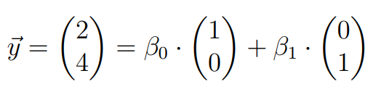
Linear combination & Basis vectors
Linaer combination of (basis) vectors:
Span:
The possible (vectors) resulting from linear combinations of vectors.
i-hat and j-hat span the two-dimensional plane (why?).
Linear independence:
Vectors are not multipla of each other.
Formally: linear combination can only result in 0-vector if all beta = 0.

Slide 10
Tasks: see Exercise 1 (hand-out)

Slide 11
Anyone wants to share?

Slide 12
2. Linear combinations and least squares

Slide 13
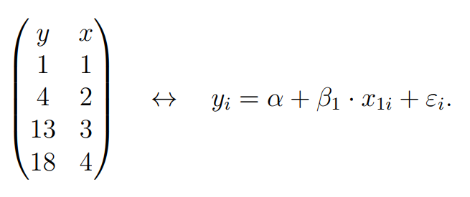
Q: How Y, Beta and Epsilon are vectors and X is a matrix (1)
Q: How do these notions relate?

Slide 14
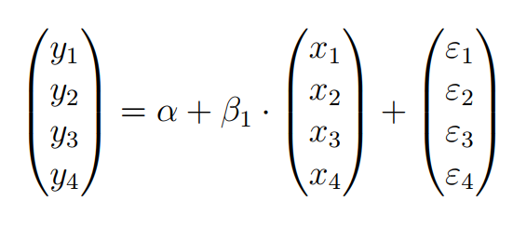
Q: How Y, Beta and Epsilon are vectors and X is a matrix (2)
Outcome (y) as linear combination:

Slide 15
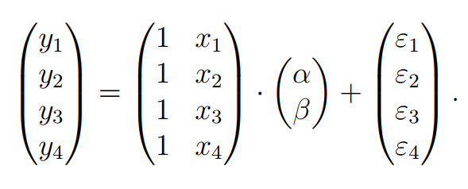
Q: How Y, Beta and Epsilon are vectors and X is a matrix (3)
Refine the representation:

Slide 16
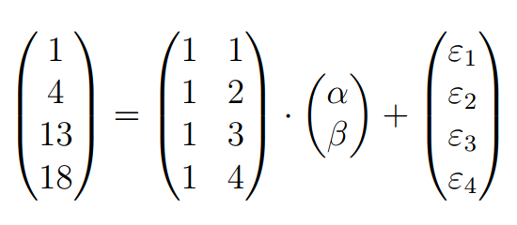
Q: How Y, Beta and Epsilon are vectors and X is a matrix (4)
Now with actual values:

Slide 17
Q: How Y, Beta and Epsilon are vectors and X is a matrix (5)
What does everything represent here?
What are we interested in?
Notes:
X: design matrix (not interested → data)
Y: outcome (not interested → data)
Vector with alpha and beta: parameters → what we want to estimate.
Epsilon: residual error → we want this to be minimized.

Slide 18
Q: How Y, Beta and Epsilon are vectors and X is a matrix (6)
Does it have a solution?
How do we interpret this?
Notes:
Does not have a solution.
Y cannot be written as a linear combination of our data (design matrix).

Slide 19
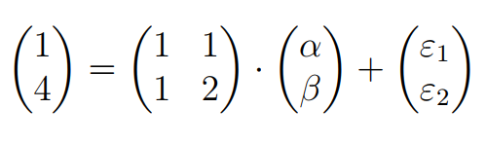
When a solution exists (example)
One subject less.
2 equations with 2 unknowns.
In most cases this has a solution (when does it not?)
Notes:
When does it not: when the matrix has non-linearly independent vectors.
Then it only spans R and not R^2.

Slide 20
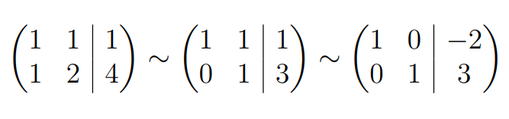
How do we solve equations?
Gauss-Jordan elimination and RREF:
1. swap two rows.
2. multiply a row by non-zero number.
3. adding a multiple of one row to another.

Slide 21
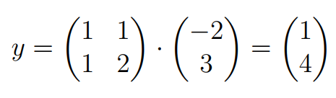
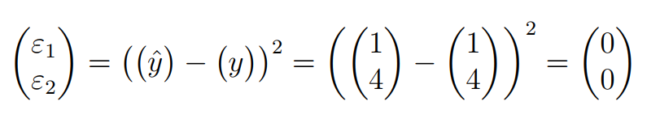
Checking the solution
1. Do the matrix multiplication with the found values for alpha and beta.
2. Subtract the resulting vector from the actual outcome vector.
3. Now we can check our (squared) errors:

Slide 22
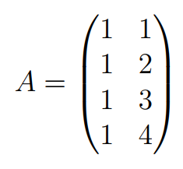
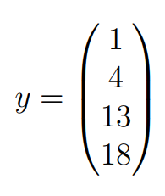



When no solution exists (least squares approximation)
Returning to our earlier example:
What we want to do:
First:
Second:
Third: This can be solved (as the previous example) with Gauss-Jordan elimination.
Notes:
So just some initial steps → and then we do the same (go back to that slide).

Slide 23
Tasks: see Exercise 2 (hand-out)

Slide 24
Anyone wants to share?

Slide 25
Take-aways?

Slide 26
Some of my take-aways (1)
1. R^2 is model comparison (against grand mean)
2. More predictors always gives better R^2 (adjusted r-squared and F-statistic)
3. The number of columns in the design matrix → the number of parameters we estimate.
4. Dummy variable (0 & 1 → gender for instance) is modelled just as any other (numeric) variable. Thus it is natural that a t-test is a linear combination (and thus linear model).
Notes:
Recall what is not linear: logistic regression → that would be linear and then a non-linear transformation of the output.
We have clearly seen that what we transform (e.g. with quadratic) is the input space (design matrix).

Slide 27
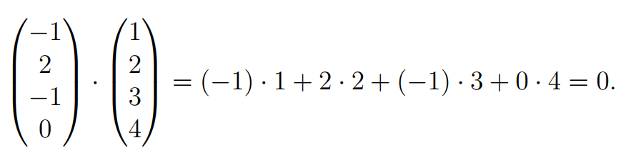
Some of my take-aways (2)
5. When no solution exists it is because the y-vector is outside of the span of predictors.
What we find is the orthogonal projection of y- onto the x-plane. Two vectors are orthogonal if they are perpendicular to each other – and this is computed as the dot-product:
6. Example from our calculations:
Notes:
But actually all vectors in our design matrix will be orthogonal to this vector.

Slide 28
Tasks: see exercise 3 (in R)
Notes:
More data (fake data I created).
Analyse it with an eye for what the models are actually implying.
Thinking visually / mathematically about why one might be better than another.
When something is significant – what is it significantly better than?

Slide 29
Other use-cases of algebra

Slide 30
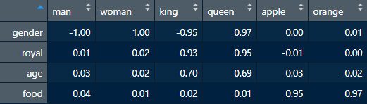
1: word embeddings (1)
The concept (NLP): represent words as a vectors in many dimensions (300+).
This place in n-dimensions is the words embedding.
Example: 6 words (columns) represented in 4 dimensions (rows)

Slide 31
1. Word embeddings (2)
Why is it useful?
1. Maybe this is how humans represent words and word-similarity (implicitly)?
2. Suppose we have an NLP model which is trained to understand that
”drinking orange ______” should be followed by ”juice” will be able to generalize to understand that ”drinking apple ______” is also likely to be followed by ”juice” because they are close to each other.
3. How do we measure similarity? Suggestions?

Slide 32
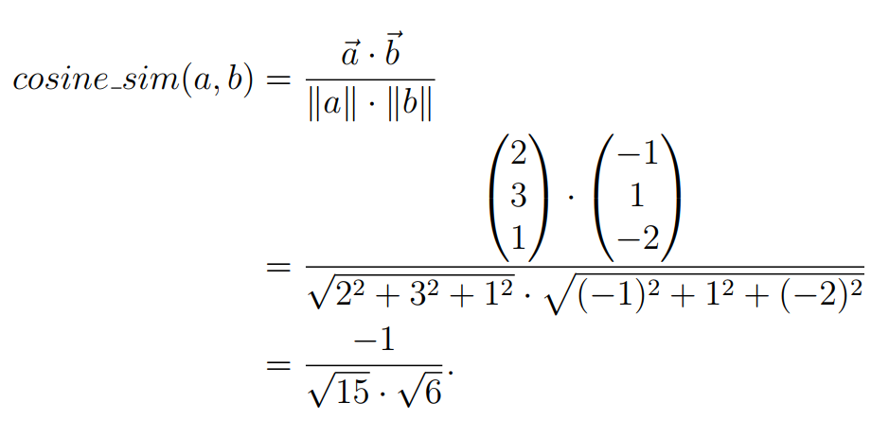
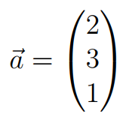
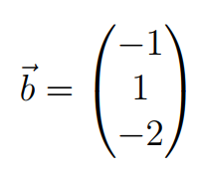
1: Word embeddings (3)
Distance between these word-vectors as cosine similarity:
Cosine similarity is the dot product of two vectors divided by their length/norm (multiplied).
Example (which does not really make sense because we have not normalized):
Notes:
Euclidean norm & dot product.

Slide 33
Tasks: See exercise 4 (in R)

Slide 34
2: PCA (covariance matrix and eigenvectors)
What it does:
Reduce dimensionality of data (e.g. 300D → 2D)
How this works (roughly):
Scale all your predictors (z-score).
Form a covariance matrix.
Find eigenvectors and eigenvalues for this matrix.
The eigenvectors with the largest (absolute) eigenvalues explain most variance.
Transform data from high to low dimension.
Notes:
We can talk about some of the specifics afterwards, but it is somewhat more involved mathematically.

Slide 35
Tasks: See exercise 5 (in R)
Notes:
We can discuss the mathematics after you have played with it.

Slide 36
Thank you for today
On the Github:
1. example solution code (as .Rmd).
2. this powerpoint.

Slide 37
References
3Blue1Browns amazing ”essence of linear algebra” series: https://www.youtube.com/watch?v=fNk_zzaMoSs&list=PLZHQObOWTQDPD3MizzM2xVFitgF8hE_ab
StatQuest ”linear models” series: https://www.youtube.com/watch?v=nk2CQITm_eo
StatQuest PCA: https://www.youtube.com/watch?v=FgakZw6K1QQ

